Slide 1
Comparison of C++ and Java

Slide 2
Pass parameters to base class
C++
class Pet { public: // Constructors, Destructors Pet () : weight(1), food("Pet Chow") {} Pet(int w) : weight(w), food("Pet Chow") {} Pet(int w, string f) : weight(w), food(f) {} ~Pet() {}
}
class Rat: public Pet { public: Rat() {} Rat(int w) : Pet(w) {} Rat(int w, string f) : Pet(w,f) {} ~Rat() {}
}
Java
class Pet { public: // Constructors, Destructors Pet () {} Pet(int w) {} Pet(int w, string f) {} ~Pet() {}
}
class Rat: public Pet { public: Rat() {} Rat(int w) { super(w) ;
…….
} Rat(int w, string f) {
super(w,f);
……
} ~Rat() {}
}

Slide 3
Array
C++
class Pet {
};
Usage
Pet allpets[100] ;
// declare 100 objects, memory space is allcated. Constructor is called 100 times
Java ++
class Pet {
}
Usage
Pet allpets[100] ;
// declare 100 reference, no objects are allocated
---- somewhere -----
for (i=0; i<100; i++) {
allpets[i] = new Pet();
}

Slide 4
Parameter Passing to methods
C++
For all primitive type or class type, they can be passed by
pass by value
pass by address
pass by reference
Java
Primitive Types (int, char, float, double…)
Only pass by value
Class types (a.k.a., objects)
only pass by reference

Slide 5
Object allocation
C++ (for primitive types or any class types)
Global variable (in data segment)
Local variable ( in stack)
Heap variable
Java
Global variable : can be approximated via static inside a class
Local variable (for primitive types only)
Heap variable (for any class types or primitive types)

Slide 6
Abstract class
C++
Class human {
int weight ;
int height ;
Public:
virtual void walk()=0;
virtual void speak()=0;
}
C++
public abstract Class human {
int weight ;
int height ;
public abstract void walk() ;
Public abstract speak();
}

Slide 7
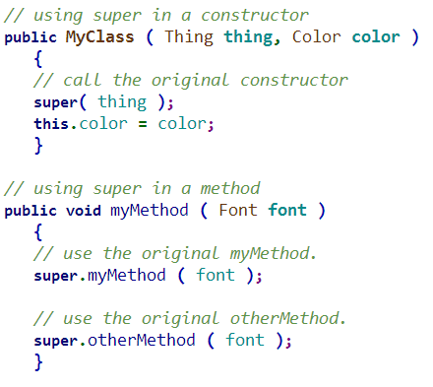
Inheritance
C++
Pass parameter to constructor from subclass to base class
Use initialization member list
Java
In the constructor, if you use super(), it must be the very first code, and you can not access any this. xxx variables or methods to compute its parameters.

